Slide 1
Do It Tomorrow
Y
Conor Sargent
Colm Mulhall
Daniel Hogan
Robert Lowe

Slide 2
Game objective
The player needs to interact with obstacles and remove enemies from the game.
Acquire an extra life as game bonus.
Player only has to battle one tank at a time.
Notes:
Here we will have the player learning the environment. Learning controls and interacting with indestructible obstacles. Using them as shields to defeat enemy tanks and gain power ups to advance within the game.

Slide 3
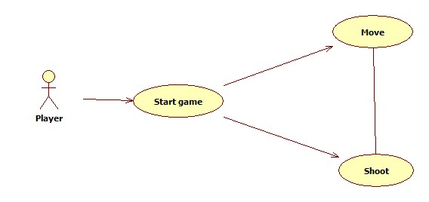
Use case
The only user for our system will be a human playing against AI
The player can shoot from the tank and move
Notes:
The user or player will have 2 options when they start the game. To shoot at the enemy & to move the tank and to adjust aim for the tank. We wont have more than one user at a time.

Slide 4
Development process
Waterfall or STAR design?
Which will work for the development of a prototype game?
The answer is SCRUM because it is difficult to plan ahead.
Notes:
Which design do we think would best suit a game? It does not have the same cycle as a rental system or a library management system does it? No, a game needs feedback each step of the way. To redefine what works within the game environment and what doesn’t. We don’t always have a specific goal in sight our ideas can be brought upon by our current state of mind and what step we are in.

Slide 5
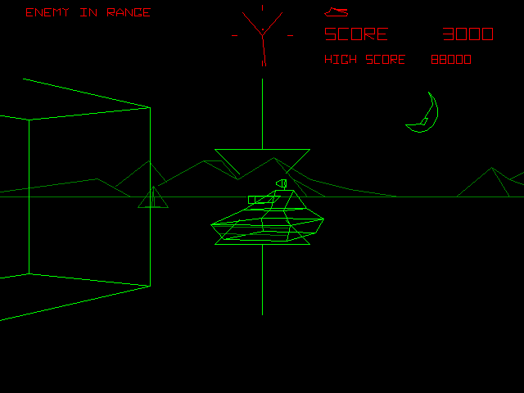
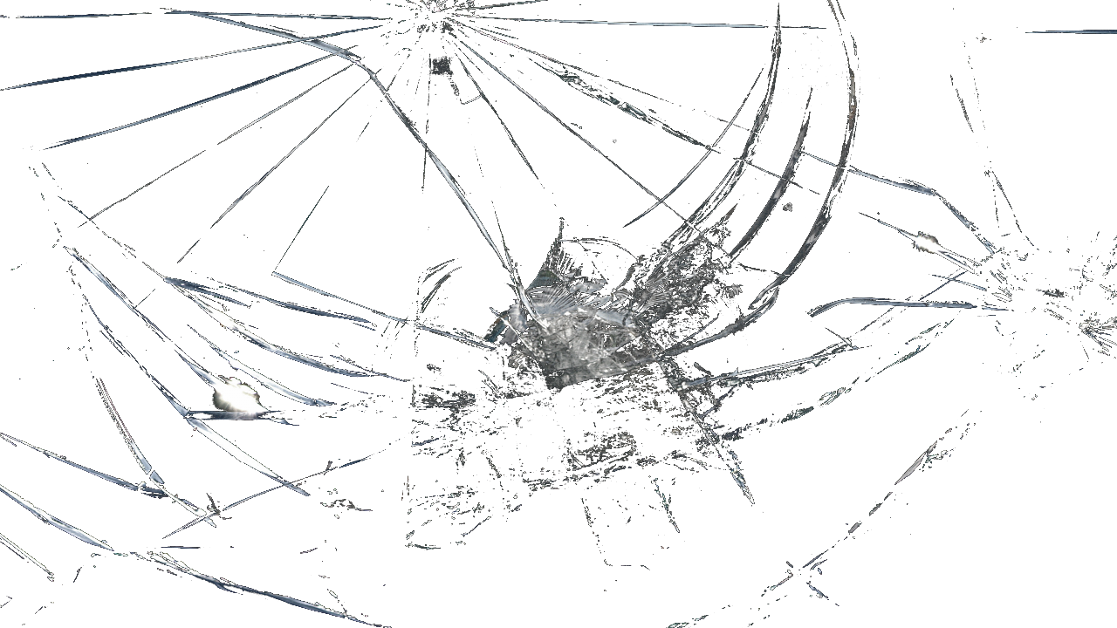
Features
We want to modernize the original tank game Battlezone. Using wireframe as additional features and screen cracks to indicate player health.
Notes:
This will also help add features gradually to the game. Understanding how things work and why things work we can increase features more and more into the game.

Slide 6
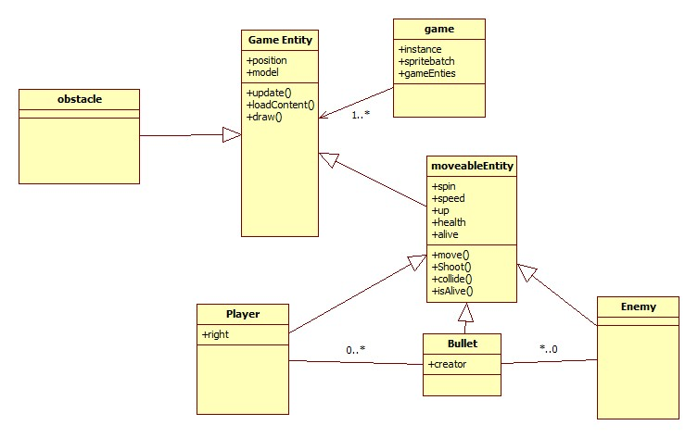
Class diagram
The XNA framework provides us with specific classes like game and game entity.
Notes:
The XNA framework already has a set of classes created for the developer. So we just need to adapt them to our game. The game has game entities, some which don’t move like an obstacle and some which do. Players and enemies are generalizations of moveableEntity. Also here a player can have one or more bullets fired.

Slide 7
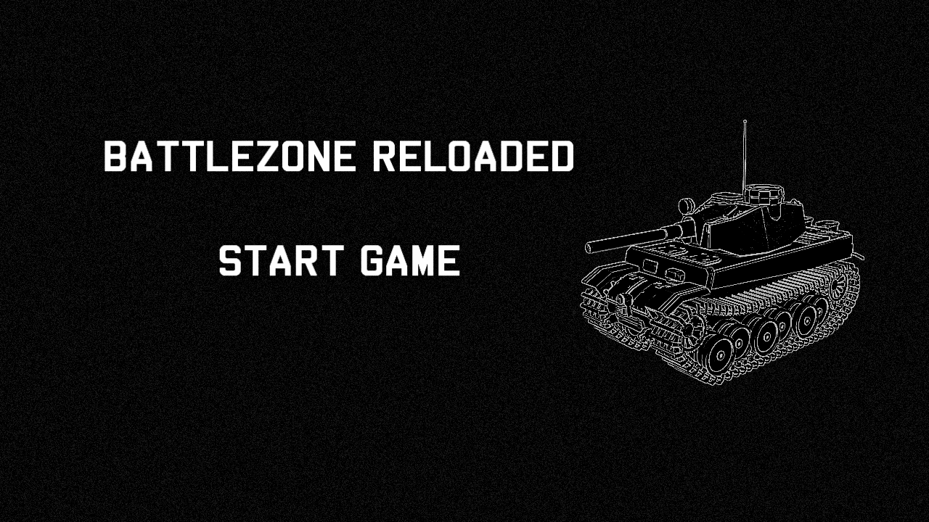
GUI prototype
Notes:
It is difficult this early to portray how the gameplay will look but we want to keep to the style of the original game. Here is just a simple start screen which could be implemented within the game which will also need an end game and possible option screen or help screen for user controls.

Slide 8
Development method
Scrum methodology.
Blender will be used for the 3d modelling. Designing the player and enemy tanks.
Coding will be delegated between each team member to maximise output.
Notes:
The methodology we decided to use was Scrum. This is an agile development method which depends on feedback and testing to redefine the game and increase the amount of features we can incorporate. It is also difficult to plan ahead for the design of the game when we have little knowledge about problems we will face in a the environment.

Slide 9
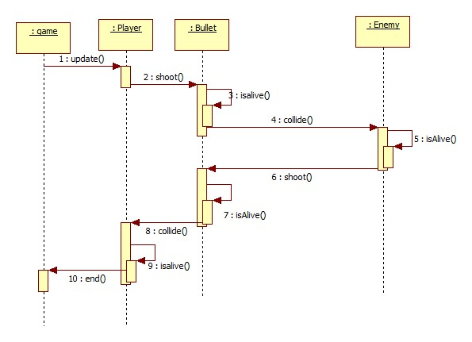
Sequence diagram
Player shooting interaction
Notes:
Here we have a simple diagram to explain the player shooting at an enemy. We will have to implement a kind of bounding box and attach it to the model to understand when or if a bullet will intersect with an enemy or player. And remove the object according to what collisions occur.

Slide 10
Questions?
How would you implement controls? Plausible solution using the Kinect after keyboard implementation.
What will the models look like? The models will be box shaped tanks with textures rendered onto them.
How is wireframe implemented? Damage taken by the player tank will cause wireframe viewpoint of environment.

